Slide 1


Nour Eddine Ben Nejma
08-02-2023

Slide 2

Outline
Executive Summary
Introduction
Methodology
Results
Conclusion
Appendix

Slide 3
Executive Summary
Summary of methodologies
Data Collection with API
Data Collection with Web Scraping
Data Wrangling
Exploratory Data Analysis with SQL and Data Visualization
Interactive Visual Analysis with Folium and Dash
Machine Learning Prediction
Summary of all results
Exploratory Data Analysis result
Interactive analytics in screenshots
Predictive Analytics result (Machine Learning Lab)

Slide 4
Introduction
Project background and context
SpaceX advertises Falcon 9 rocket launches on its website, with a cost of 62 million dollars; other providers cost upward of 165 million dollars each, much of the savings is because SpaceX can reuse the first stage. Therefore, if we can determine if the first stage will land, we can determine the cost of a launch. This information can be used if an alternate company wants to bid against SpaceX for a rocket launch.
Problems you want to find answers
What features determine the landing outcomes?
What are the relationships between those features?
What state of these features determine the best outcome?

Slide 5

Section 1

Slide 6
Methodology
Executive Summary
Data collection methodology:
Data collected through SpaceX RESTful API and Web Scraping from Wikipedia
Perform data wrangling
Data processed through one-hot encoding for categorical features
Perform exploratory data analysis (EDA) using visualization and SQL
Perform interactive visual analytics using Folium and Plotly Dash
Perform predictive analysis using classification models
Data split into training testing data.
Training Data used with different classification models.
Hyperparameter grid search applied for parameter tuning

Slide 7
Data Collection
Data collection is the process of gathering data for use in business decision-making, strategic planning, research and other purposes. It's a crucial part of data analytics applications and research projects: Effective data collection provides the information that's needed to answer questions, analyze business performance or other outcomes, and predict future trends, actions and scenarios.
We used the SpaceX REST API to collect the Data.
We also used Web Scraping to collect Data from Wikipedia.
Next, we present our data collection process.

Slide 8
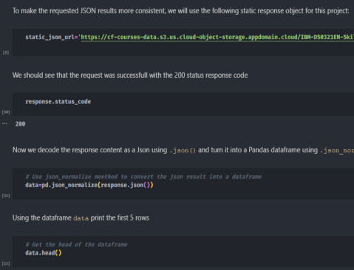
Data Collection – SpaceX API
Get request for rocket launch data using API
Use json_normalize() method to convert JSON result to Dataframe
For more details:
Notebook link on Github

Slide 9
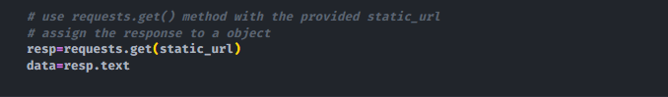
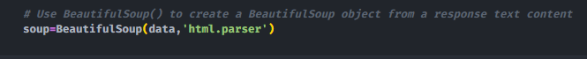
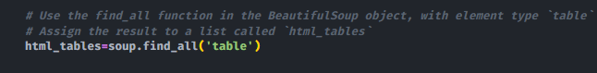
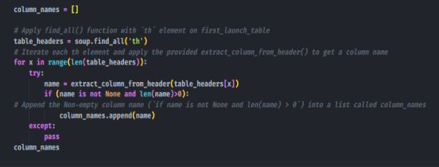
Data Collection - Scraping
Request the Falcon9 Launch Wikipedia page from url
Create a BeautifulSoup from the HTML response
Extract all column/variable names from the HTML header
For more details:
Notebook link on Github

Slide 10
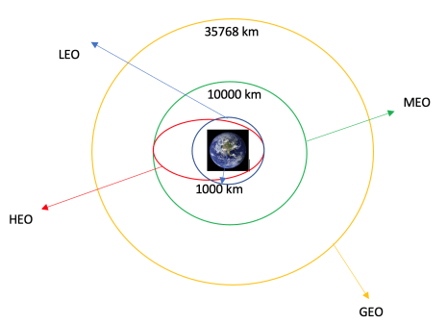
Data Wrangling
Data wrangling is the process of cleaning and unifying messy and complex data sets for easy access and analysis. With the amount of data and data sources rapidly growing and expanding, it is getting increasingly essential for large amounts of available data to be organized for analysis.
We calculate the number of launches at each site, and the number and occurrence of each orbits
We create landing outcome label from outcome column and export the results to csv.
For more details:
Notebook link on Github

Slide 11
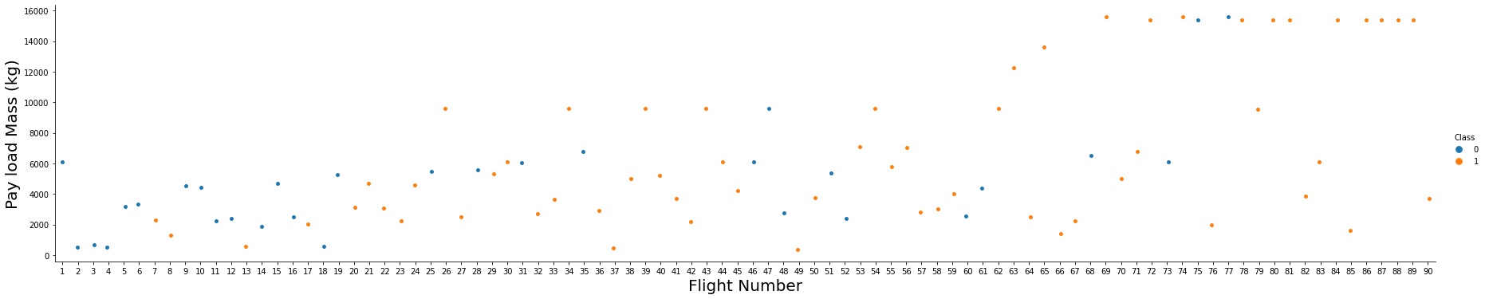
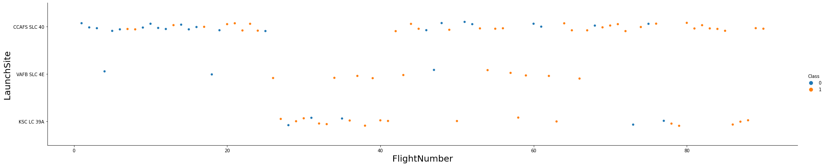
EDA with Data Visualization
We used scatter graph to find the relationship between the attributes such as between:
Payload and Flight Number.
Flight Number and Launch Site.
Payload and Launch Site.
Flight Number and Orbit Type.
Payload and Orbit Type.
Scatter plots show dependency of attributes on each other. Once a pattern is determined from the graphs. It’s very easy to see which factors affecting the most to the success of the landing outcomes.
Notebook link on Github

Slide 12
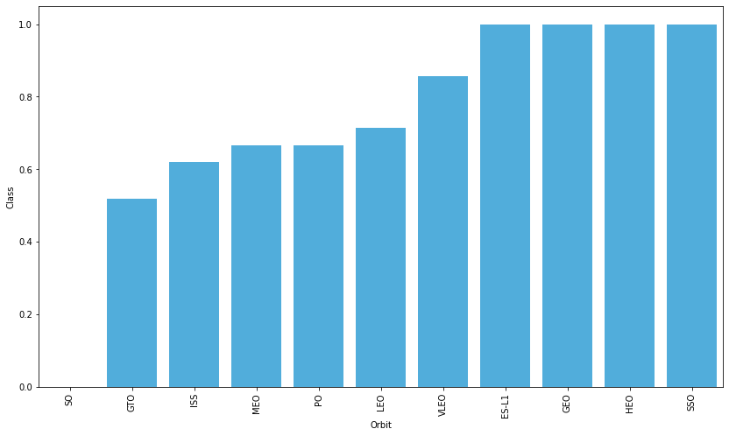
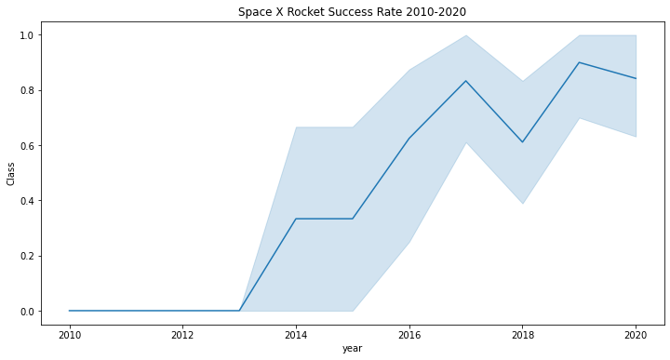
EDA with Data Visualization
Bar graphs is one of the easiest way to interpret the relationship between the attributes. In this case, we used a bar chart to determine which orbits have the highest probability of success.
We used a line graph to show a trends or pattern of the attribute over time which in this case, is used for see the launch success yearly trend.
Notebook link on Github

Slide 13
EDA with SQL
We loaded the SpaceX dataset into an IBM db2 database. We applied EDA with SQL to get insight from the data. We wrote queries to find out for instance:
the names of the launch sites.
5 records where launch sites begin with the string ‘CCA’.
the total payload mass carried by booster launched by NASA (CRS).
the average payload mass carried by booster version F9 v1.1.
the date when the first successful landing outcome in ground pad was achieved.
the names of the boosters which have success in drone ship and have payload mass greater than 4000 but less than 6000.
the total number of successful and failure mission outcomes.
the names of the booster_versions which have carried the maximum payload mass.
the failed landing_outcomes in drone ship, their booster versions, and launch sites names for in year 2015.
the count of landing outcomes or success between the date 2010-06-04 and 2017-03-20, in descending order.
Notebook link on Github

Slide 14
Build an Interactive Map with Folium
We marked all launch sites, and added map objects such as markers, circles, lines to mark the success or failure of launches for each site on the folium map.
We assigned the feature launch outcomes (failure or success) to class 0 and 1.i.e., 0 for failure, and 1 for success.
Using the color-labeled marker clusters, we identified which launch sites have relatively high success rate.
We calculated the distances between a launch site to its proximities. We answered some question for instance:
Are launch sites near railways, highways and coastlines.
Do launch sites keep certain distance away from cities.
Notebook link on Github

Slide 15
Build a Dashboard with Plotly Dash
We built an interactive dashboard with Plotly dash which allowing the user to play around with the data as they need.
We plotted pie charts showing the total launches by a certain sites.
We then plotted scatter graph showing the relationship with Outcome and Payload Mass (Kg) for the different booster version.
Explain why you added those plots and interactions
Notebook link on Github

Slide 16
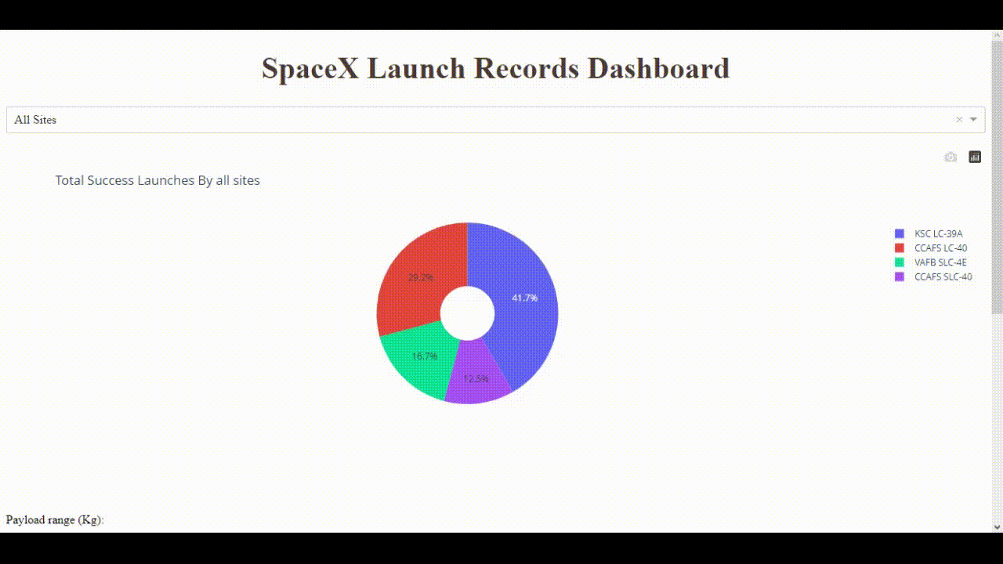
Build a Dashboard with Plotly Dash
This is a GIF (see pptx file)
Notebook link on Github

Slide 17
Predictive Analysis (Classification)
We loaded the data using numpyand pandas, transformed the data, split our data into training and testing.
We built different machine learning models and tune different hyperparameters using GridSearchCV.
We used accuracy as the metric for our model, improved the model using feature engineering and algorithm tuning.
We found the best performing classification model.
Notebook link on Github

Slide 18
Results
Exploratory data analysis results
Interactive analytics demo in screenshots
Predictive analysis results

Slide 19

Section 2

Slide 20
Flight Number vs. Launch Site
This plot shows that the larger the flights number of each launch site, the greater the success rate will be.

Slide 21
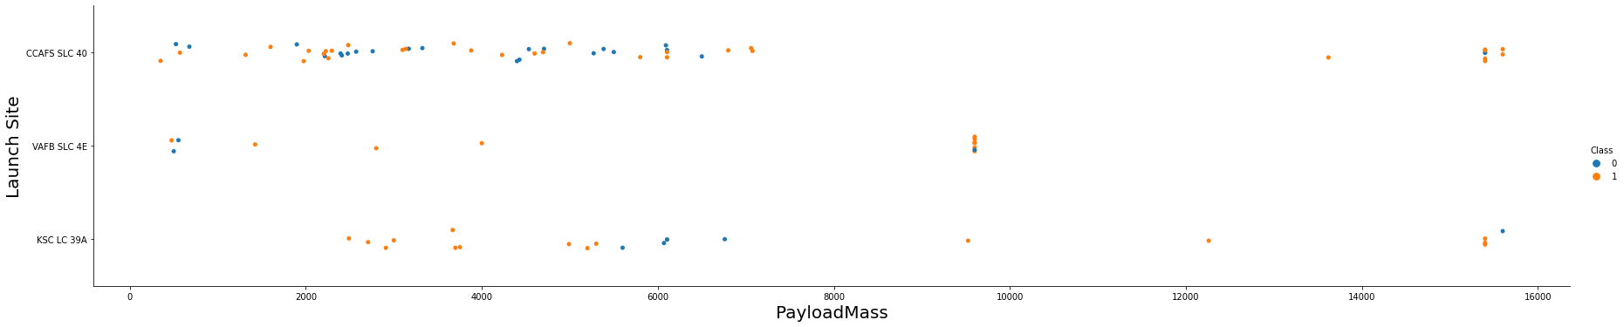
Payload vs. Launch Site
This scatter plot shows once the pay load mass is greater than 7000kg, the probability of the success rate will be highly increased.
However, there is no clear pattern to say the launch site is dependent to the pay load mass for the success rate.

Slide 22
Success Rate vs. Orbit Type
This chart depicted the
possibility of the orbits to influences the landing outcomes as some orbits has 100% success rate such as SSO, HEO, GEO AND ES-L1 while SO orbit produced 0% rate of success.

Slide 23
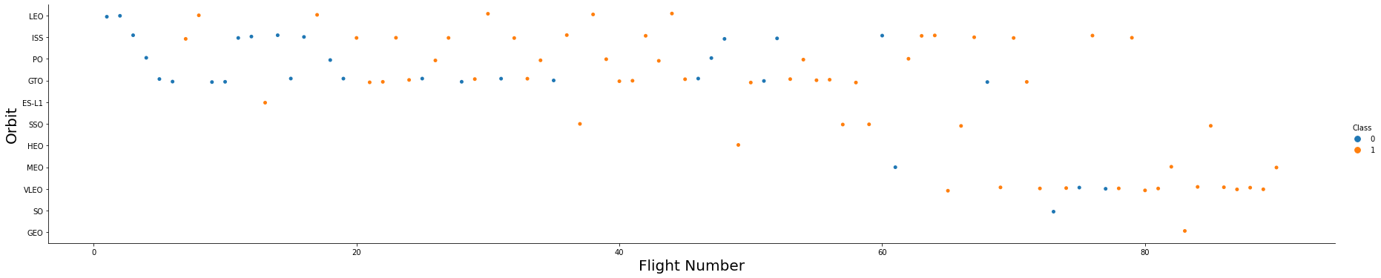
Flight Number vs. Orbit Type
We see that in the LEO orbit the Success appears related to the number of flights; on the other hand, there seems to be no relationship between flight number when in GTO orbit.

Slide 24
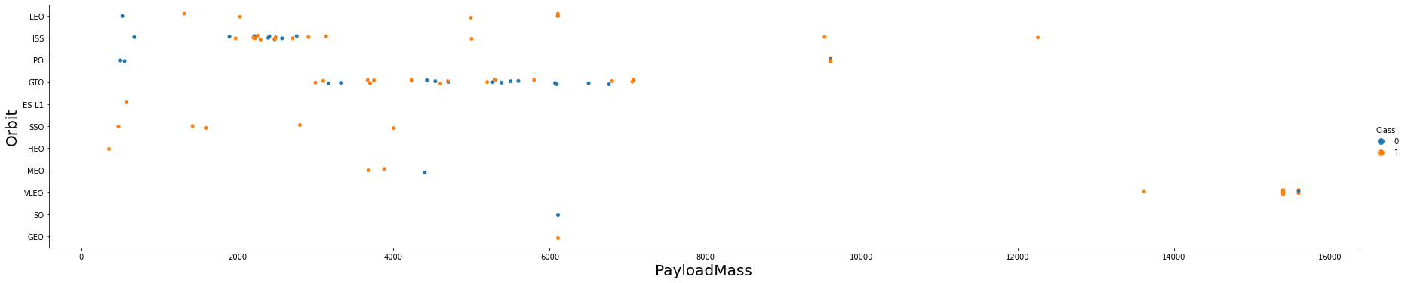
Payload vs. Orbit Type
With heavy payloads the successful landing or positive landing rate are more for Polar, LEO and ISS. However, for GTO we cannot distinguish this well as both positive landing rate and negative landing(unsuccessful mission) are both there here.

Slide 25
Launch Success Yearly Trend
you can observe that the success rate since 2013 kept increasing till 2020

Slide 26
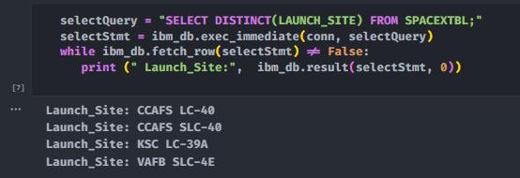
All Launch Site Names
We used the key word DISTINCT to show only unique launch sites from the SpaceX data.

Slide 27
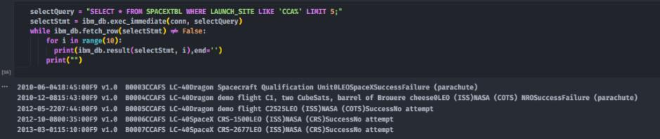
Launch Site Names Begin with 'CCA'
We used the query above to display 5 records where launch sites begin with `CCA`

Slide 28
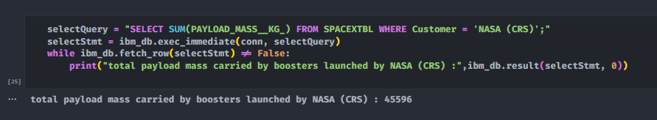
Total Payload Mass
We calculated the total payload carried by boosters from NASA
as 45596 using the query below

Slide 29
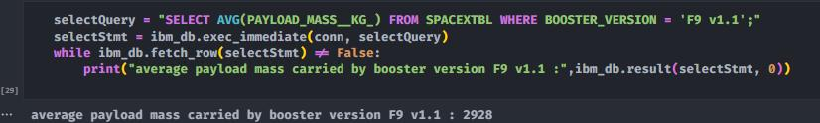
Average Payload Mass by F9 v1.1
We calculated the average payload mass carried by booster version F9 v1.1 as 2928

Slide 30
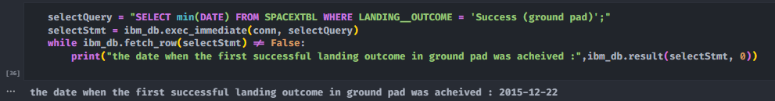
First Successful Ground Landing Date
We use the min() function to find the result.
The dates of the first successful landing outcome in ground pad was 22nd December 2015

Slide 31
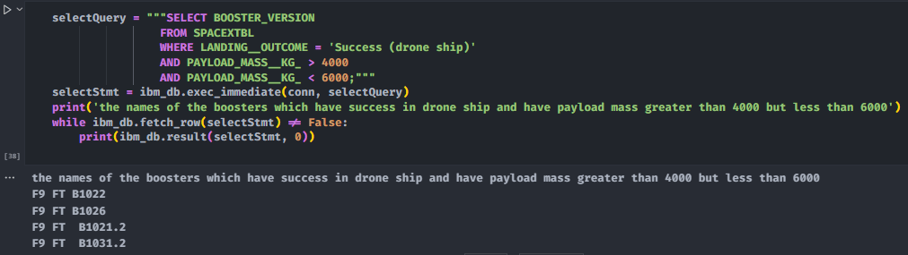
Successful Drone Ship Landing with Payload between 4000 and 6000
We used the WHERE clause to filter for boosters which have successfully landed on drone ship and applied the AND condition to determine successful landing with payload mass greater than 4000 but less than 6000

Slide 32
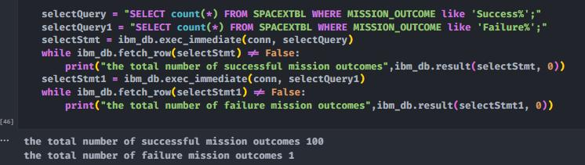
Total Number of Successful and Failure Mission Outcomes
We used wildcard like ‘%’ to filter for WHERE Mission Outcome was a success or a failure.

Slide 33
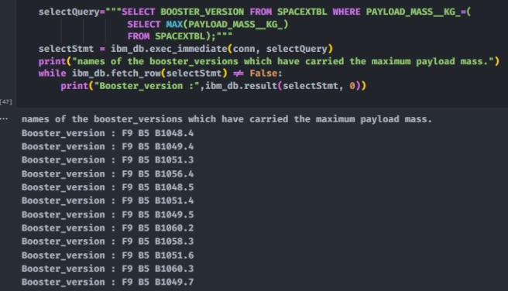
Boosters Carried Maximum Payload
We determined the
booster that have
carried the maximum
payload using a
subquery in the
WHERE clause and
the MAX() function.

Slide 34
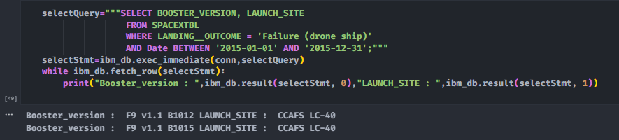
2015 Launch Records
We used a combinations of the WHERE clause, LIKE, AND, and BETWEEN conditions to filter for failed landing outcomes in drone ship, their booster versions, and launch site names for year 2015

Slide 35
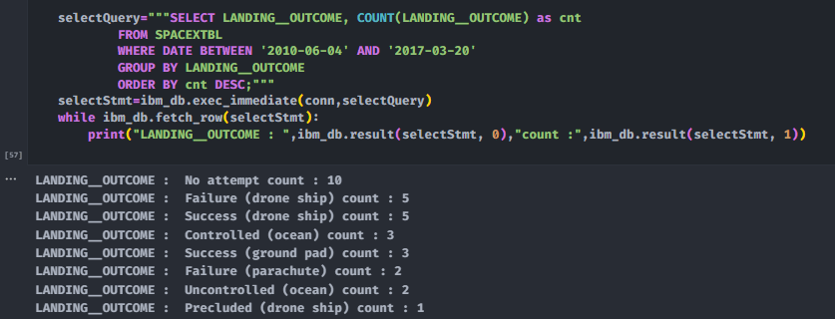
Rank Landing Outcomes Between 2010-06-04 and 2017-03-20
We selected Landing outcomes and the COUNT of landing outcomes from the data and used the WHERE clause to filter for landing outcomes BETWEEN 2010-06-04 to 2010-03-20.
We applied the GROUP BY clause to group the landing outcomes and the ORDER BY clause to order the grouped landing outcome in descending order.

Slide 36

Section 3

Slide 37
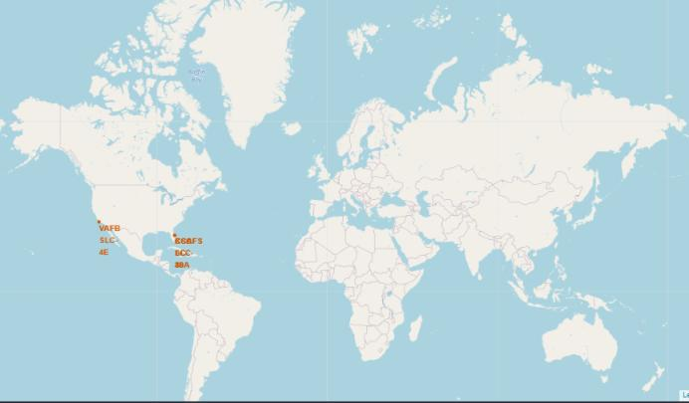
Location of all the Launch Sites
We can see that all the SpaceX launch sites are located inside the United States

Slide 38
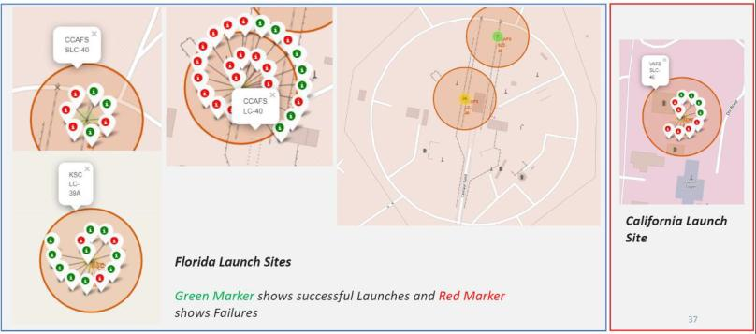
Markers showing launch sites with color labels

Slide 39
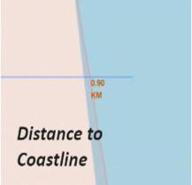
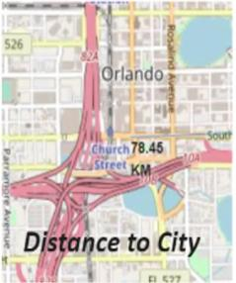
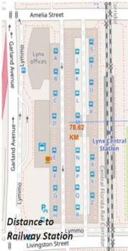
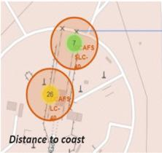
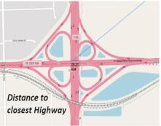
Launch Site distance to landmarks
Are launch sites near railways?
NO
Are launch sites near highways?
NO
Are launch sites near coastline?
YES
Do launch sites keep certain distance away from cities?
YES

Slide 40

Section 4

Slide 41
This is a GIF (see pptx file)
We can see the success percentage by each sites.
We can see Payload vs Launch Outcome Scatter Plot

Slide 42

Section 5

Slide 43
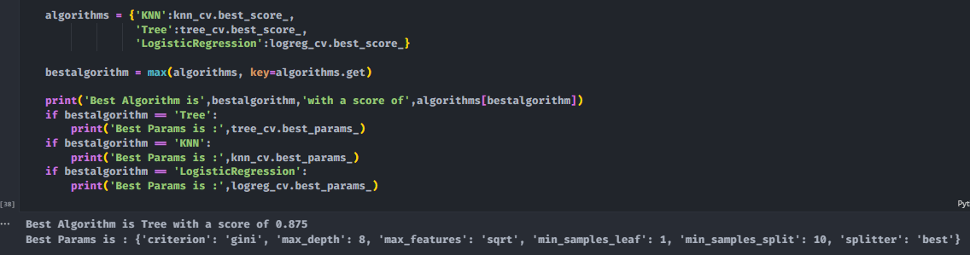
Classification Accuracy
The decision tree classifier is the model with the highest classification accuracy

Slide 44
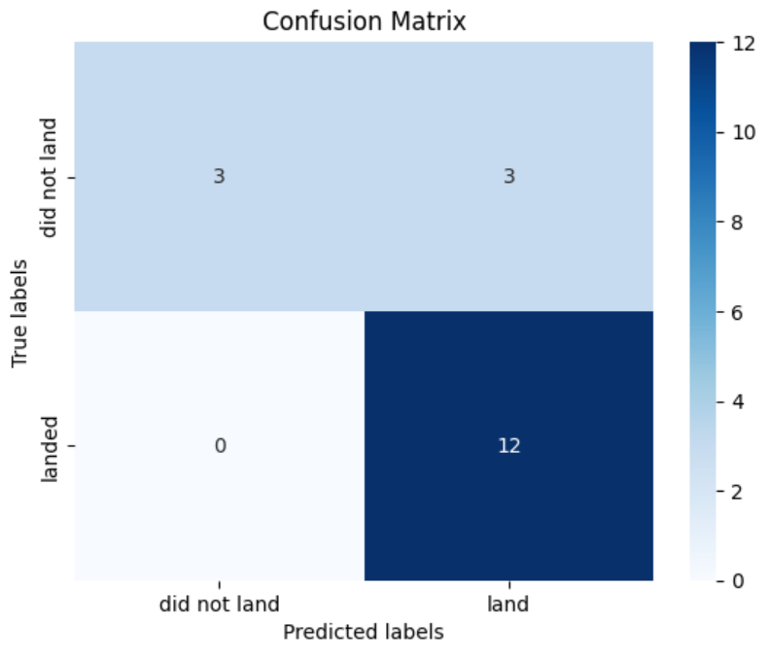
Confusion Matrix
The confusion matrix for the decision tree classifier shows that the classifier can distinguish between the different classes. The major problem is the false positives .i.e., unsuccessful landing marked as successful landing by the classifier.

Slide 45
Conclusions
We can conclude that:
The larger the flight amount at a launch site, the greater the success rate at a launch site.
Launch success rate started to increase in 2013 till 2020.
Orbits ES L1, GEO, HEO, SSO, VLEO had the most success rate.
KSC LC 39A had the most successful launches of any sites.
The Decision tree classifier is the best machine learning algorithm for this task.

Slide 46


